Slide 1
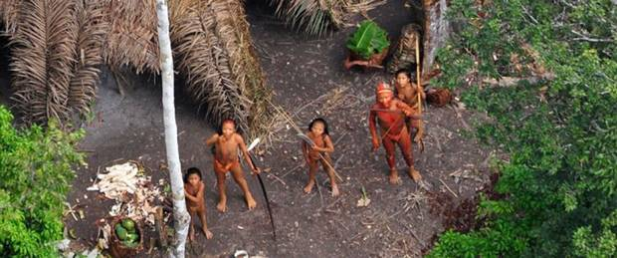
EC01: I Come in Peace
6th Presentation
G107 Effective Communication

Slide 2
Learning Outcomes
State the importance of communication using the Communication Model.
Show awareness that communication is both verbal and non-verbal.
Explain the factors that played a part in the packaging of the message using CAPS.

Slide 3
Problem Analysis
Context
Jungle environment
Audience
Purpose
Structure
The Lost Tribe
Persuade by sending the message “I Come in Peace”
Introduction, Body, Conclusion

Slide 4

Interactive Communication Model
MESSAGE
SENDER/
RECEIVER
RECEIVER
/SENDER
FEEDBACK
According to the Interactive Communication Model,
when communication occurs, sender and receiver
take turns to send and receive messages and feedback

Slide 5
Communication is two-way process and comprises the verbal communication component
Interactive Communication Model
Verbal:
Thank you for your help.
MESSAGE
SENDER/
RECEIVER
RECEIVER
/SENDER
FEEDBACK
Verbal:
You’re welcome.

Slide 6
Communication is two-way process and comprises the non-verbal communication component
Interactive Communication Model
Non-Verbal:
Eye Contact
(“I am sincere”)
MESSAGE
SENDER/
RECEIVER
RECEIVER
/SENDER
FEEDBACK
Non-Verbal:
Smiling
(“I am friendly”)

Slide 7
C.A.P.S.
To avoid miscommunication, it is ideal that the following factors are considered prior to any form of communication:
Context
Audience
Purpose
Structure

Slide 8
Communication takes place
within a CONTEXT
CONTEXT
MESSAGE
SENDER/
RECEIVER
RECEIVER
/SENDER
FEEDBACK
CONTEXT
Notes:
REVISED

Slide 9


Analysing the Context
Context is the extent to which your present environment influences the way you act towards others.
Certain environments might cause you to alter your posture, manner of speaking, attire or means of interacting.
When considering context, think in terms of the occasion, the social and cultural forces at play, the style of communication, and the form or medium of communication.
Basically, sociocultural factors are customs, lifestyles and values that characterize a society. More specifically, cultural aspects include aesthetics, education, language, law and politics, religion, social organizations, technology and materialculture, values and attitudes.

Slide 10

Communication always
involves an AUDIENCE
MESSAGE
SENDER/
RECEIVER
RECEIVER
/SENDER
FEEDBACK
AUDIENCE
Notes:
REVISED

Slide 11
Analysing the Audience
Examining your audience’s motives, demographics and psychographics will allow you to craft your message so that it is communicated more effectively
Motives | Demographics | Psychographics
Motivation Problems Pains | Age Gender Education Religion, etc. | Attitudes Personality Habits Values

Slide 12
Analysing the Audience
It is important to challenge your assumptions and conduct sufficient research on your target audience.
While one can make some valid generalizations about the target audience, it is important not to stereotype them. For example,
Working professionals may tend to have spending power, but one should not assume that all of them prefer to buy luxury branded products.
Housewives may not be in the workforce, but we should not assume that all of them are uneducated and prefer only discounted products.
Senior citizens are older and may have retired from the workforce, but not all of them are slow or not tech-savvy.
Notes:
NEW

Slide 13
General Audience
“The general public” cannot be considered a target audience.
The “general” audience does not exist.
When communicating to the public, you are actually communicating with specific members of the public or those you hope will become interested.
Hence your audience should always be a specific group of people.
Notes:
REVISED

Slide 14
Communication has PURPOSE
Communication has a PURPOSE
MESSAGE
SENDER/
RECEIVER
RECEIVER
/SENDER
FEEDBACK
I NEED TO PERSUADE HIM TO…
MAYBE I SHOULD DO WHAT HE SAYS
PURPOSE

Slide 15
Analysing the Purpose
Why is this communication important?
Why is it needed?
What will users do with this information?
For a message to be effective, you should know exactly why you plan to send it.
The Main Purposes of Communication:
Inform: To convey important facts or information
Persuade: To persuade the receiver to accept or reject certain conditions or actions
Entertain: To entertain the receiver
Motivate: To motivate the receiver to act in a specific way
Stimulate: To stimulate discussion about a particular issue
Communication can also have other purposes such as to instruct, warn, greet, or request information.
Notes:
REVISED
The Five Components of a Communication Model. (n.d.). In DirecTutor. Retrieved September 10, 2015, from http://www.directutor.com/content/five-components-communication-model

Slide 16

Communication has STRUCTURE
MESSAGE
MESSAGE
SENDER/
RECEIVER
RECEIVER
/SENDER
FEEDBACK
FEEDBACK
FIRST….
THEN….
FINALLY….
I UNDERSTAND WHAT YOU ARE SAYING
STRUCTURE
Notes:
REVISED

Slide 17
Analysing the Structure
Introduction
Message structured to evoke interest
Body
Content organised in a certain order to serve a purpose
Conclusion
Summary of the key message

Slide 18

Ways to structure the Introduction
Use a quotation or catch phrase
Tell a story, incident or example
Ask provocative questions
Give startling facts or statistics
Give a hypothetical situation
Give a brief demonstration
Notes:
DELETE THIS SLIDE

Slide 19

Ways to structure the Body
Information and Points
3 main ideas with facts, information and personal stories to explain your point
Notes:
DELETE

Slide 20

Ways to structure the Conclusion
The summary:
Re-emphasise main points in a memorable way (e.g. link back to the question, story, or statement that was highlighted in the introduction)
Closing thoughts:
Motivate the audience to respond or act
Inspirational appeal or challenges
Notes:
DELETE

Slide 21

APPLICATION TO PROBLEM

Slide 22
Using the Interactive Communication Model to illustrate the communication process to the scientists
Verbal:
Not possible because
the language is unknown
MESSAGE
SENDER/
RECEIVER
(The Scientists)
RECEIVER
/SENDER
(The Tribe)
FEEDBACK
Non-Verbal:
Hostile?
Friendly?
Non-Verbal:
Give Maracuja and Suri Palm Grubs as gifts
Men to communicate with men
Women communicate with women
Pay attention to Feedback

Slide 23


Context
Environment → Jungle
Food → Only those that are available in the jungle environment
Suggestion:
The scientist should give Maracuja and Suri Palm Grubs as gifts to demonstrate that they are coming in peace.

Slide 24

Audience
Gender Roles → Men and women stay in different longhouses
Status → The man without the red paint on the face and upper body is probably the leader.
Suggestions:
Ensure women communicate with women and men communicate with men.
Initiate communication with the leader

Slide 25
Purpose
Persuade → Convey the message “I come in peace”
Suggestions:
Focus on the needs of the tribe.
Provide a solution to a problem in the tribe (e.g. provide food to reduce starvation)

Slide 26
Structure
Introduction
Use a demonstration to start the conversation (e.g. eat the Maracuja and Suri Palm Grubs in-front of the tribe)
Body
Convey the message by using non-verbal cues mimicking first the most non-threatening gestures and subsequently following with another.
Conclusion
Give gifts (e.g. Maracuja) that the tribe needs to reinforce the message that they are coming in peace.

Slide 27
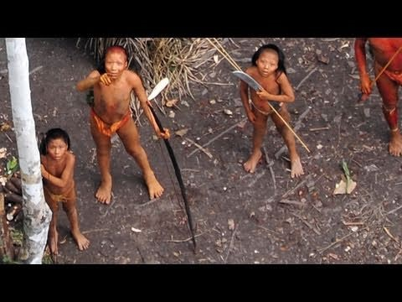
Uncontacted Amazon Tribe: First ever aerial footage
S. (2011, February 08). Uncontacted Amazon Tribe: First ever aerial footage. Retrieved March 25, 2016, from https://www.youtube.com/watch?v=sLErPqqCC54

Slide 28

Uncontacted Amazon Tribe:
First ever aerial footage (Webpage)
Uncontacted Tribes - Films from Survival International. (2011, February 4). Retrieved March 07, 2017, from http://www.uncontactedtribes.org/brazilfootage
Notes:
INSTRUCTIONS TO FACILITATORS: ‘Live’ Webpage embedded. Please go to “Slide Show” mode to view. If script errors appear, click “NO” to close all dialog boxes, you can still view the full webpage live on your PowerPoint without changing to Internet Explorer/Google Chrome Browsers to view it.

Slide 29
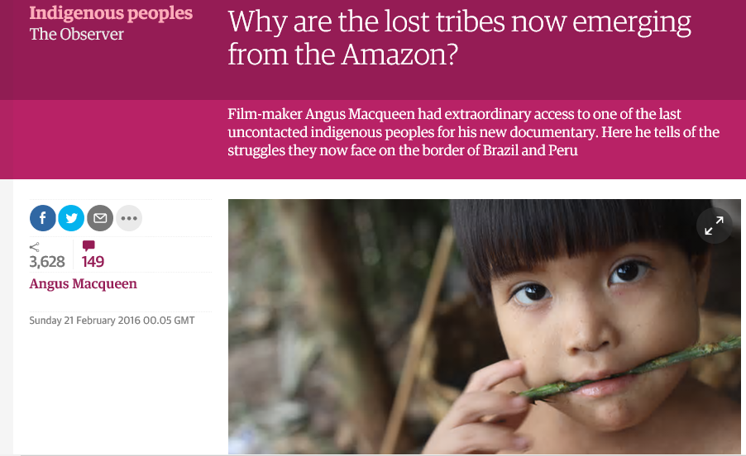
Why are the lost tribes now emerging from the Amazon? (Webpage)
Macqueen, A. (2016, February 21). Why are the lost tribes now emerging from the Amazon? Retrieved March 07, 2017, from http://www.theguardian.com/world/2016/feb/21/amazon-lost-tribes-emerge-rainforest-brazil-peru?CMP=fb_gu
Notes:
INSTRUCTIONS TO FACILITATORS: ‘Live’ Webpage embedded. Please go to “Slide Show” mode to view. If script errors appear, click “NO” to close all dialog boxes, you can still view the full webpage live on your PowerPoint without changing to Internet Explorer/Google Chrome Browsers to view it.

Slide 30

Extended Learning
Why be a good communicator?
Helps you present your ideas, clearly and coherently.
Enables you to improve your interpersonal & relationship skills.
Great leaders are great communicators.
Improves your critical and creative thinking skills.
Good Communication Skills for Teens - Let's Face It! (2013, June 24). Retrieved March 07, 2017, from https://www.youtube.com/watch?v=_UTx6iPLsH4

Slide 31
Concept Map
Context
Audience
Purpose
Structure
Effective
Communication

Slide 32
References
References
The Five Components of a Communication Model. (n.d.). In DirecTutor. Retrieved February 22, 2015, from http://www.directutor.com/content/five-components-communication-model
De Vito, J. (2012). The Basic Course - International Edition (12th ed.). New York, NY: Pearson Education Inc.Wood, J. T. (2009).
Basic Speech Structure (n.d.). In College of Charleston. Retrieved February 22, 2015, from http://foxa.people.cofc.edu/speechstructure.html
Red Zone Marketing. (2013, June 24). Good Communication Skills for Teens - Let's Face It! [Video file]. Retrieved from http://www.youtube.com/watch?v=_UTx6iPLsH4
Johnston, B. (2010, February 28). Purpose, Audience and Context Lesson [Video file]. Retrieved from http://www.youtube.com/watch?v=c2ckoSxy1OI

